Slide 1
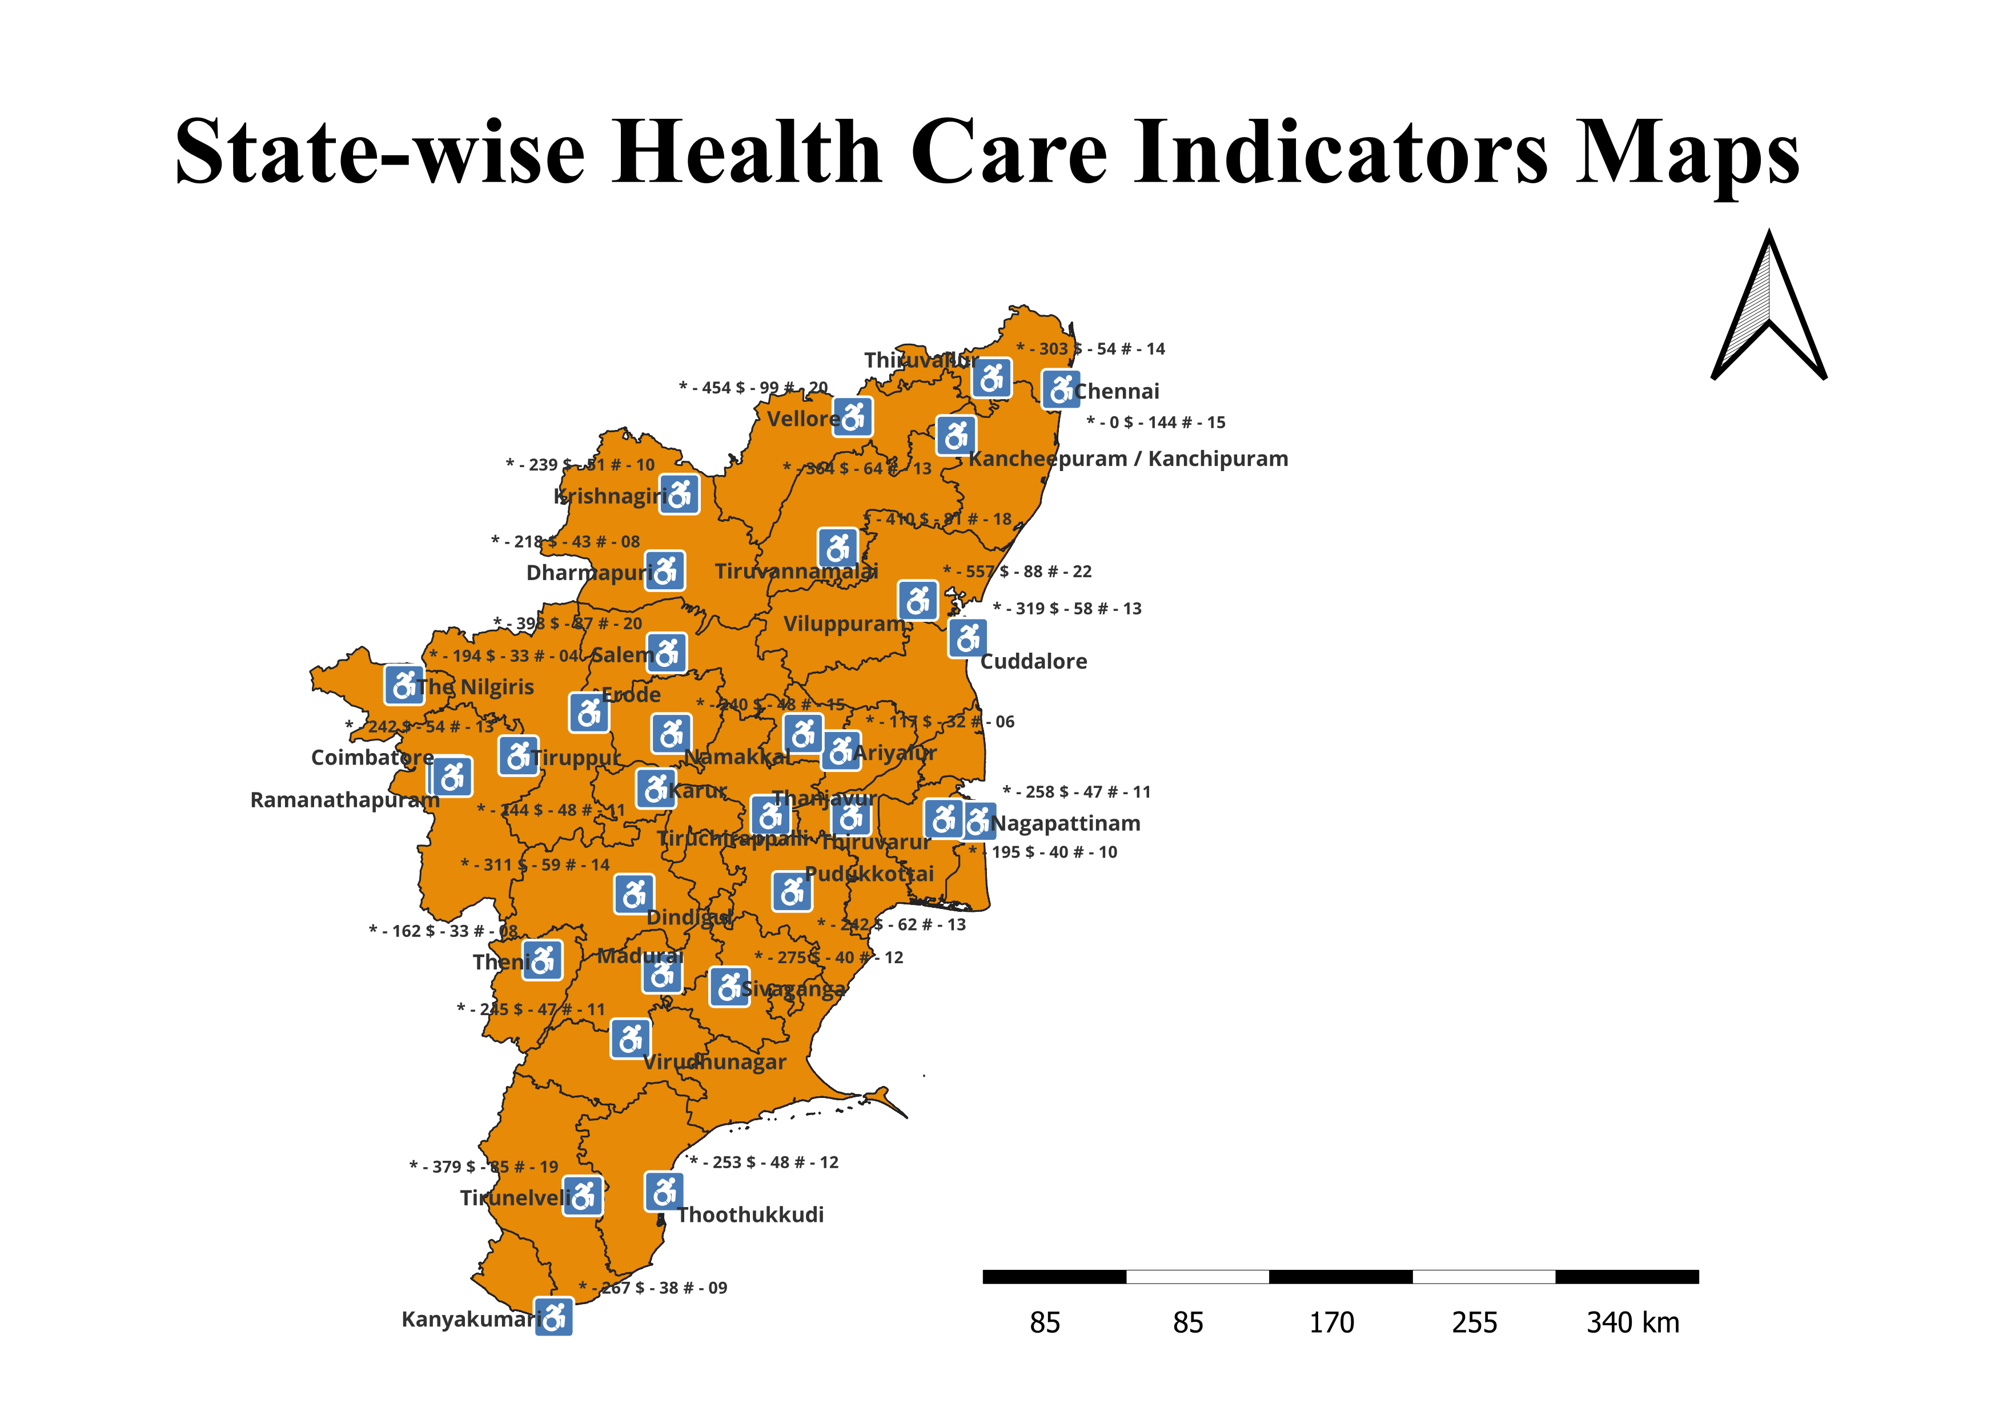

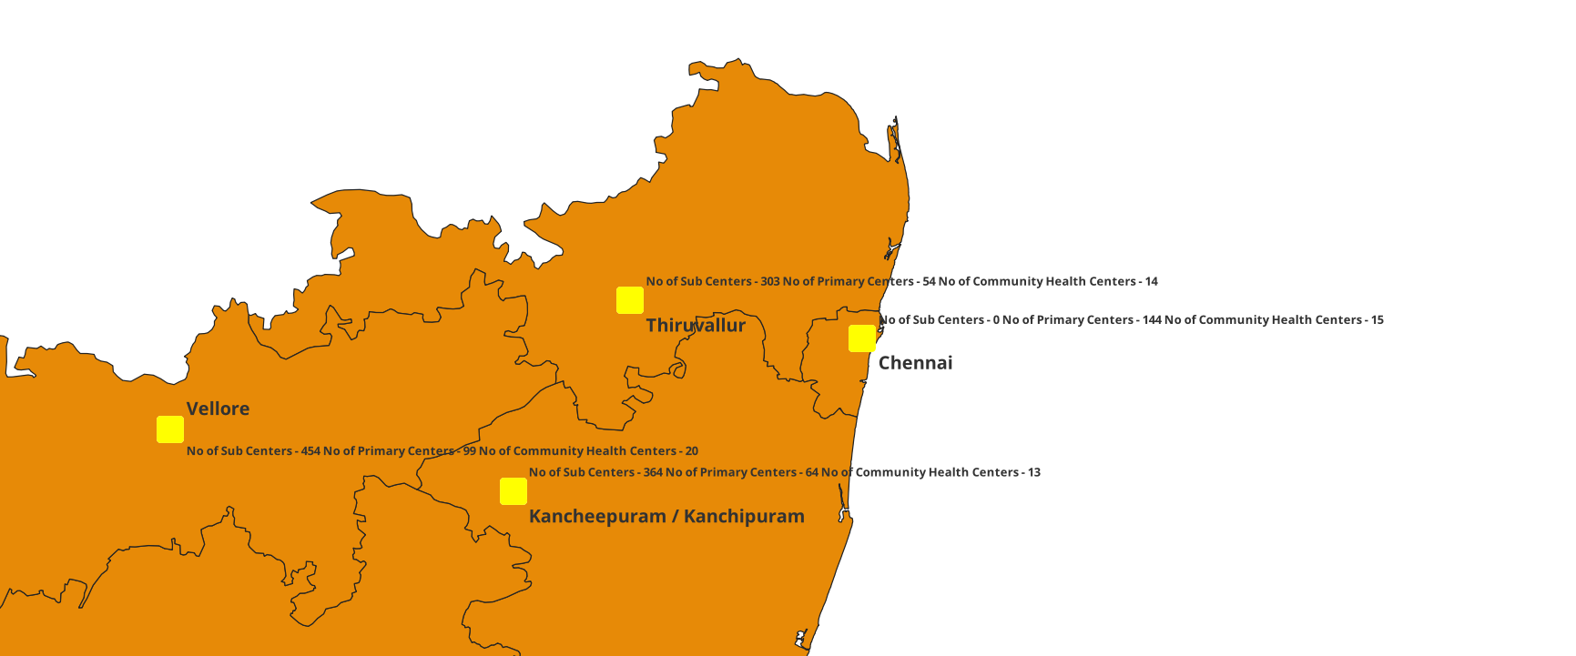

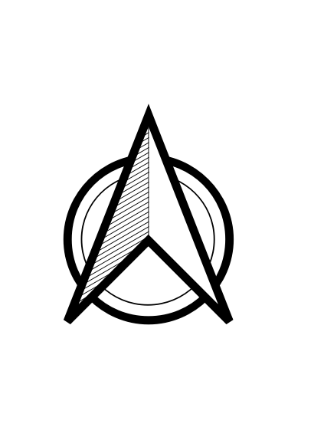



Title: State-wise Health Care Indicators Maps
Map description and analysis
Introduction:
The Tamilnadu map displays Health Care Indicator Maps, which show the number of health care centers in Tamilnadu by district.
Map Description:
The Tamilnadu map depicts health care centers by district.
The number of sub-centers, primary centers, and community health centers were counted for each district.
District Health Care Centers:
The map depicts the number of health care facilities in the district, includes Thiruvallur, Chennai, Kanchipuram, and Vellore.
Future works:
In the future, we will be able to list the health care facilities by state.
We can create a mobile application to notify authorities about the development of health care centers.
Dataset Link:
The below link contains the dataset used for the mapping of the areas:
https://drive.google.com/drive/folders/1bVWoOOqbDXTUnyVIfIGiH5RJD2UwacQp?usp=share_link
Health Care Centres
* - No of Sub Centres
$ - No of Primary Health Centres
# - No of Community health Centres
Selected Health Care Centres
Team Name: Drafters
Topic: State-wise Health Care Indicators Maps
Team lead: Hariharan D
Organization: Adhiparasakthi Engineering College

